Slide 1
Support Vector Machines(SVM)
The Impact of Hard and Soft Margins in SVMs: How the Soft Margin Parameter C Influences Classification Performance
Dinithi Dissanayaka

Slide 2
Learning objectives
Be familiar with hard margin and soft margin in SVM
Be able to apply them in classification problems
The role of C parameter in SVM
Be able to choose the best C value

Slide 3
Plan for today
Introduction to SVM
Hard margin
Soft margin
Slack Variable
C parameter
Choosing the better model
Optimal C
Cas study

Slide 4
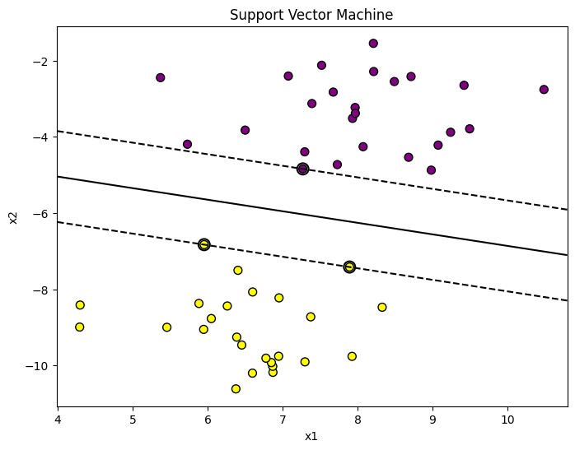
What is SVM
Maximum margin hyperplane
Supervised learning algorithm used for classification and regression tasks
Find the hyperplane that best separate data into classes.
Focus on maximizing the margin while correctly classifying.
Maximum margin
Support vectors

Slide 5
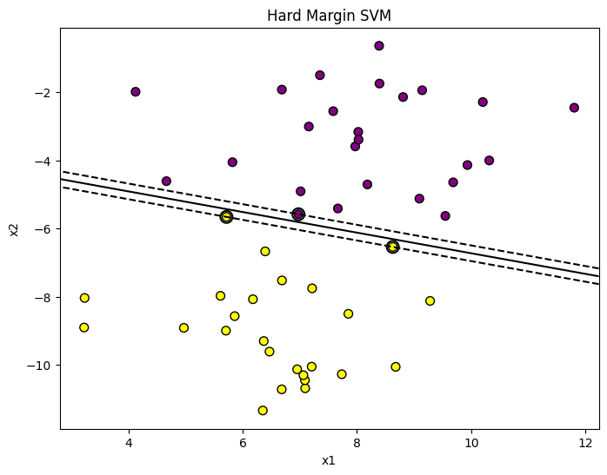

Hard margin
Perfectly separate the data by hyperplane
No points inside the margin
No misclassifications allowed

Slide 6
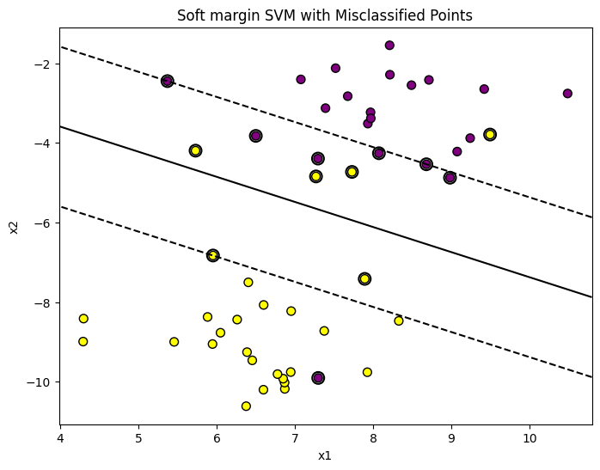
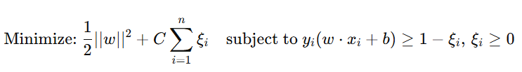
Soft margin
Allows the points inside the margin.
Allow for misclassifications to handle non separable data.

Slide 7

Slack variable
Introduce the slack variables and how they allow some points to violate the margin.
Distance of a misclassified point from its correct margin boundary.
Each data point has its own slack variable to find how much it violates the margin.
ξ = 0 : all points correctly classified
0 < ξ<1 : correctly classified, but lies inside margin
ξ >=1 : misclassified, lies in the wrong side of hyperplane.
Website:https://www.analyticsvidhya.com/

Slide 8
C parameter
Hyperparameter that controls the trade-off between maximizing the margin and minimizing margin violations.
Higher C
Strongly penalizes margin violations.
Smaller margin with fewer misclassifications.
Leading to overfitting.
Lower C
less penalizes margin violations.
Wider margin allowing more misclassifications.
Improve generalization for unseen data.

Slide 9
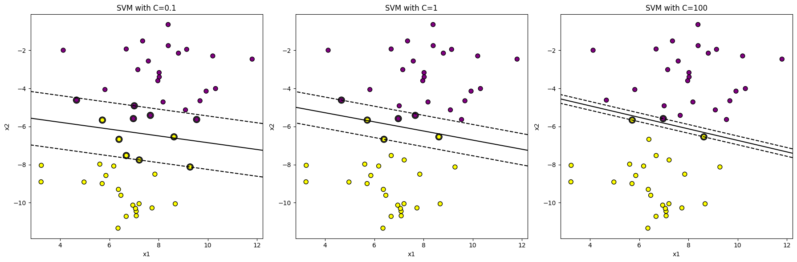

https://github.com/samindika/SVM-Tutorial

Slide 10
Choosing the better model
No correct answer
Justify using SVM Error = Margin Error + Clasificación Error
When there are outliers in data, smaller C helps to make the model robust.
Cleaned data (noise-free data), larger C is the solution, but noise may lead to overfitting.
Website:https://www.analyticsvidhya.com/

Slide 11
Optimal C
Optimal C depends on specific data set and kernel used.
Perform Grid search optimization
Perform cross validation
selecting C using the relationship between noise level and the data distribution.
(Cherkassky & Ma 2004)

Slide 12
Hyperparameter Optimization in SVMs: A Case Study in Medical Diagnostics
Systematically evaluating combinations of hyperparameters (C and γ) for different kernels to identify the best combination that maximizes classification accuracy
Parameter selection
RBF Sigmoid kernels , two hyperparameters are optimized: C and γ.
Linear kernel, only C is optimized because it does not have a γ parameter.
Range and Step Size for Grid Search:
C: Values range from 5.0 to 20.0 with a step size of 1.0.
γ: Values range from 10.00 to 5.0 with a step size of 1.0
Cross-Validation:
The dataset is split into 10 folds for 10-fold cross-validation.
(Novakovic & Veljovic 2011)

Slide 13
Classification of Frequent vs. Infrequent Customers Using SVM
Source: UCI Online Retail Dataset
Task: Classify customers as Frequent or Infrequent based on total purchase amount and invoice dates
Preprocessing – handling missing values and inconsistent data types, data scaling
Best hyperparameters - C = 100, Kernel = rbf, Gamma = scale
Results – 99% accuracy
https://github.com/samindika/SVM-Tutorial

Slide 14
References
Novakovic, J. and Veljovic, A., 2011, September. C-support vector classification: Selection of kernel and parameters in medical diagnosis. In 2011 IEEE 9th international symposium on intelligent systems and informatics (pp. 465-470). IEEE.
Cherkassky, V. and Ma, Y., 2004. Practical selection of SVM parameters and noise estimation for SVM regression. Neural networks, 17(1), pp.113-126.
Analytics Vidhya, 2024. Analytics Vidhya. Available at: https://www.analyticsvidhya.com/ [Accessed 7 Dec. 2024].
GitHub Repository: https://github.com/samindika/SVM-Tutorial

